Slide 1
EA Video Game Sales
Matthew Jue

Slide 2
Overview and problem statement
Electronic Arts Inc (EA) is one of the largest video game producing companies in the world that produces many genres of games.
With so many different types of games being produced by EA, we want to know: Is there a difference in North American games sales between EA’s sports genre and EA’s non-sports genres?

Slide 3
Exploring the Data
The dataset contains data on video games with sales greater than 100,000 copies.
The data contains information about game publishers, number of North American sales in units, European sales in units, games release year, the games genre, and more.
The data set was found on Kaggle and can be viewed here: https://www.vgchartz.com/.

Slide 4
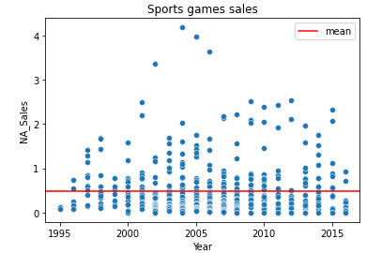
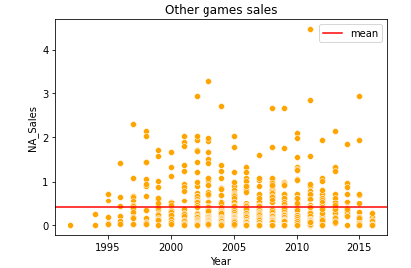
A quick look at the data
*Sales are measured in millions of units,

Slide 5
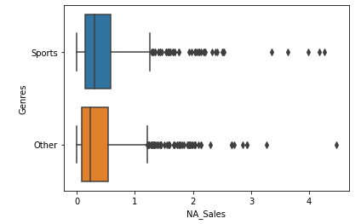
Statistically Significance
There is a statistically significant difference in units sold in North America between EA’s sports games and EA’s non-sports game.
With 95% confidence, we can say that EA’s sports games unit sales in North America are 35,000 to 120,000 units higher than EA’s non-sports games.

Slide 6
Recommendations
Prioritize sports video games but continue to invest in non-sports video games.
Gathering data from more recent years to analyze more modern game sales (games sales from 2017-2020).
Getting sales amounts in dollars to see the most lucrative games as opposed to the games with the most copies sold.
Further comparing the non-sport genres so further compare units sold by genre.
Run AB tests on the other genres.
Run AB tests on other game publishers game sales data.

Slide 7
QUESTIONS?

Slide 8
Thank You!

